Slide 1
On Ranking and Influence in Social Networks
Huy Nguyen
Lab seminar November 2, 2012

Slide 2
Agenda
Part I. Motivation and Background
Part II. Learning Influence Model and Probabilities
Part III. Learning Social Rank and Hierarchy
Part IV. Research Challenges

Slide 3
Part I Motivation and Background

Slide 4
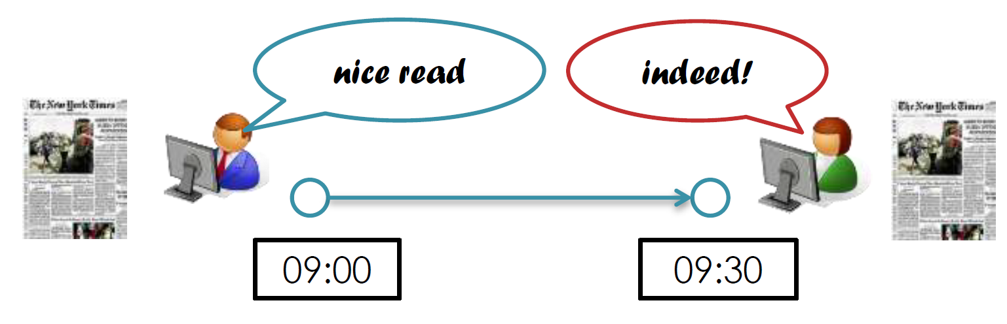
Social Influence is Everywhere
Stay connected, stay influenced [Nguyen, 2012]
Real-world story: 12K people, 50k links, medical records from 1997 to 2003
Obese Friend → 57% increase in chances of obesity
Obese Sibling → 40% increase in chances of obesity
Obese Spouse → 37% increase in chances of obesity
[Christakis and Fowler, New England Journal of Medicine, 2007]

Slide 5
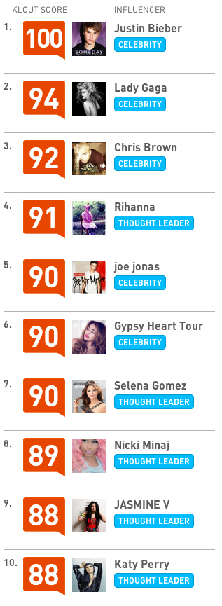
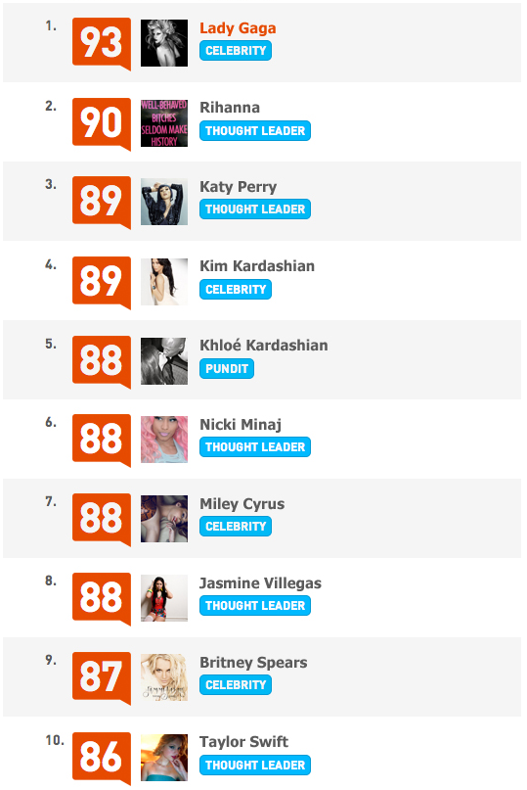
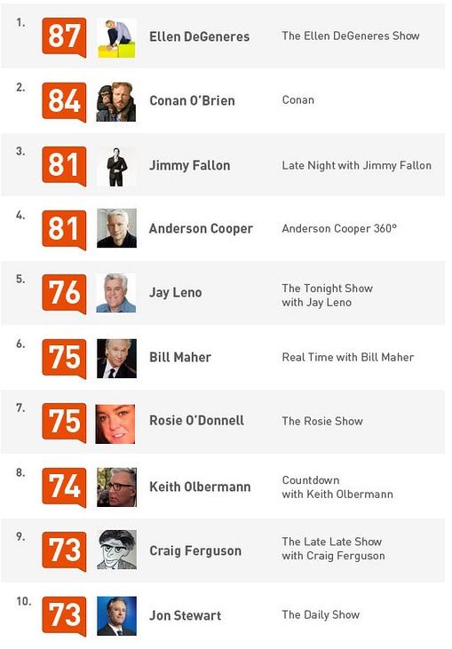
Top Influencers (by Klout)

Slide 6
How Ranking and Influence Are Related?
Conventional beliefs
Higher rank → more influence
Higher rank → less response delay (e.g.: email reply)
Higher rank → more (quality) followers
How many of them are true?
What is the true underlying relationship?
The impact is big
Devising a new influence model (with ranking)
Improve influence maximization results
Novel ranking algorithms

Slide 7

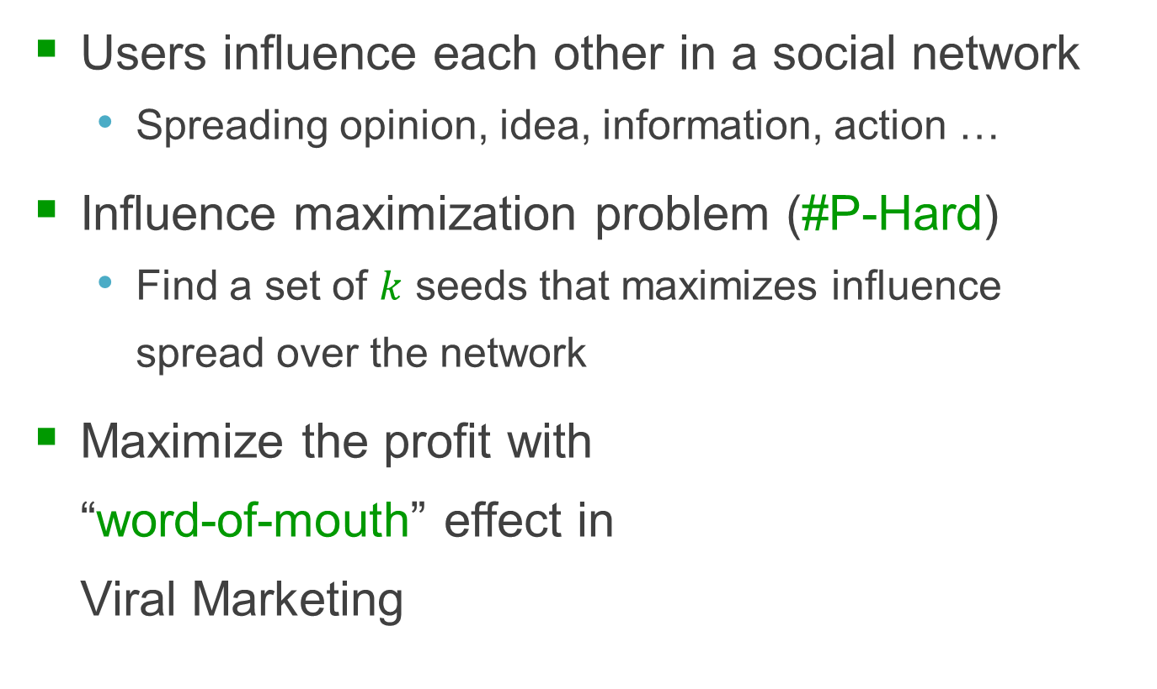
Influence Maximization (IM) Problem
Users influence each other in a social network
Spreading opinion, idea, information, action …
Influence maximization problem (#P-Hard)
Find a set of $k$ seeds that maximizes influence
spread over the network
Maximize the profit with
“word-of-mouth” effect in
Viral Marketing
iPhone 5 is great

Slide 8
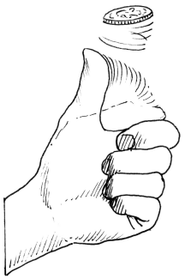
Independent Cascade (IC) Model
Spread probability associated with each edge
Influence spread = expected number of influenced nodes
0.7
0.6
0.2
Seed
0.4

Slide 9
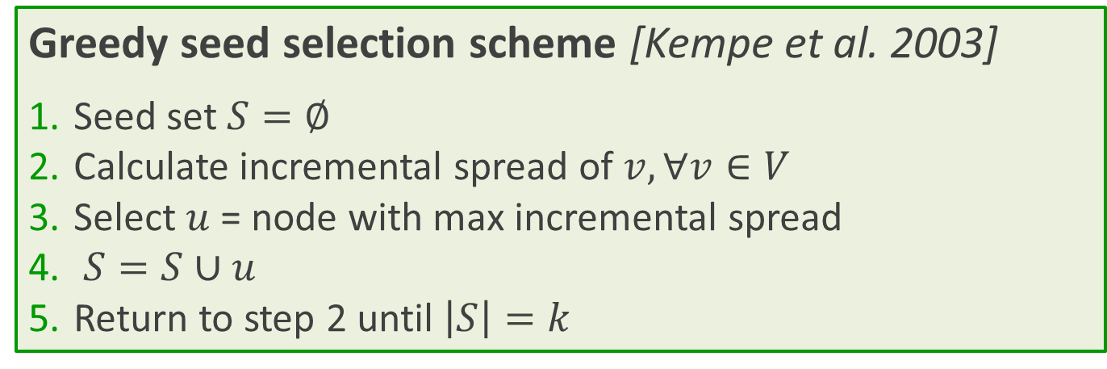
Traditional Solutions
As good as ~63% of the optimal solution
Problem
Influence spread computation
Too many evaluations after each iteration
Greedy seed selection scheme [Kempe et al. 2003]
Seed set $S=∅$
Calculate incremental spread of $v, ∀v∈V$
Select $u$ = node with max incremental spread
$S=S∪u$
Return to step 2 until $\left|S\right|=k$

Slide 10
Part II Learning Influence Models and Probabilities

Slide 11
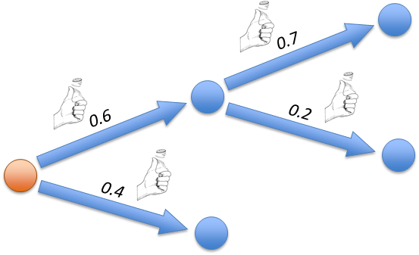
Learning Influence Models
Where do the numbers come from?
Which propagation model is correct?
LT, IC, N-IC, SIS, SIR, …
Real world social networks don’t have probabilities
Can we learn the probs. from the action log?
Sometimes we don’t even know the social network
Can we learn the social network too?
Influence probability does change over time
How can we take time into account?

Slide 12
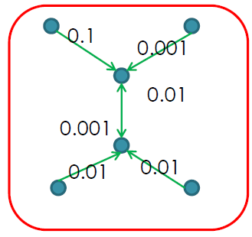
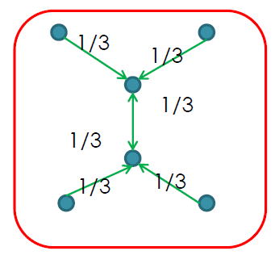
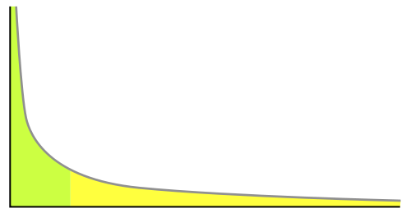
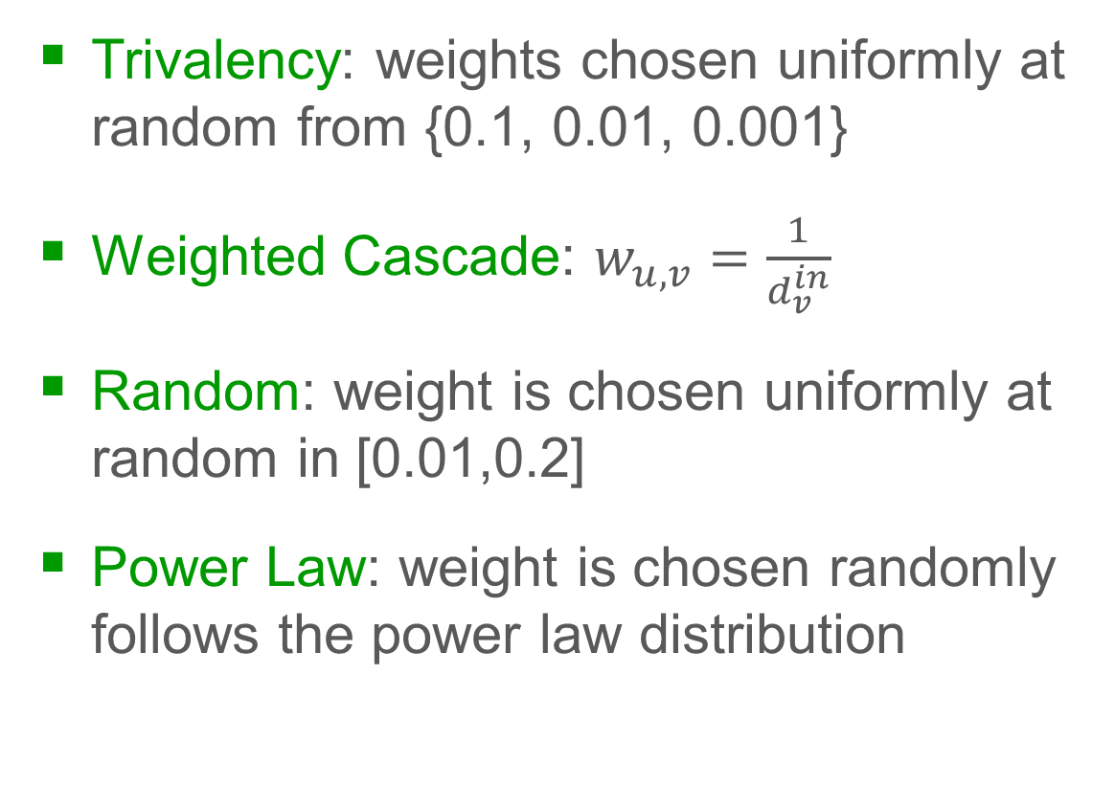
Naïve Weight Assignment Models
Trivalency: weights chosen uniformly at random from {0.1, 0.01, 0.001}
Weighted Cascade: $w_{u,v}=\frac{1}{d_{v}^{in}}$
Random: weight is chosen uniformly at random in [0.01,0.2]
Power Law: weight is chosen randomly follows the power law distribution
[Nguyen & Zheng, ECML-PKDD 2012]

Slide 13
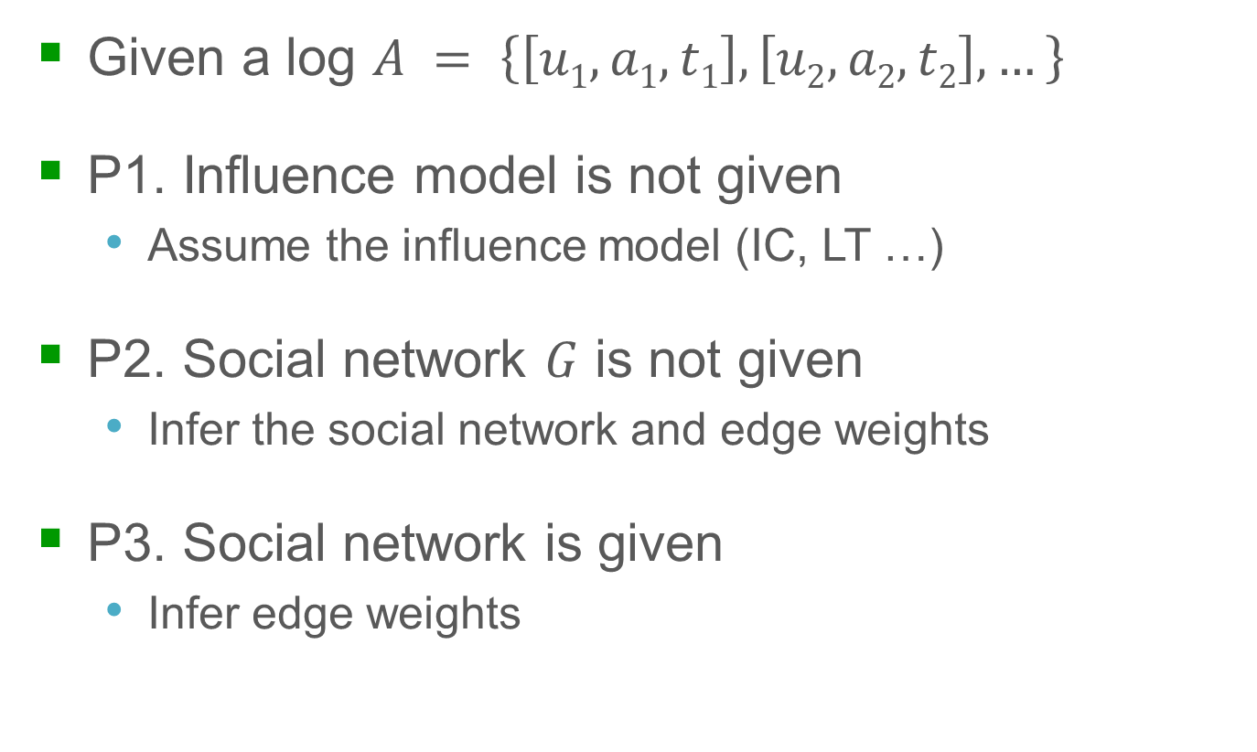
Weight Inference Problems
Given a log $A = \left\{\left[u1,a1,t1\right], \left[u2,a2,t2\right],…\right\}$
P1. Influence model is not given
Assume the influence model (IC, LT …)
P2. Social network $G$ is not given
Infer the social network and edge weights
P3. Social network is given
Infer edge weights

Slide 14
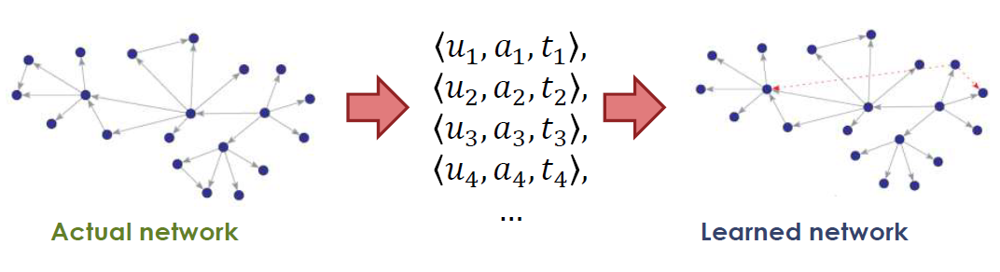
P2. Social Network is Not Given
Observe activation time
E.g.: product purchase, blogs, virus infection
Assume
Independent cascade model
Probability of a successful activation decays (exponentially) with time
[Gomez-Rodriguez, Leskovec, & Krause, KDD 2010]

Slide 15
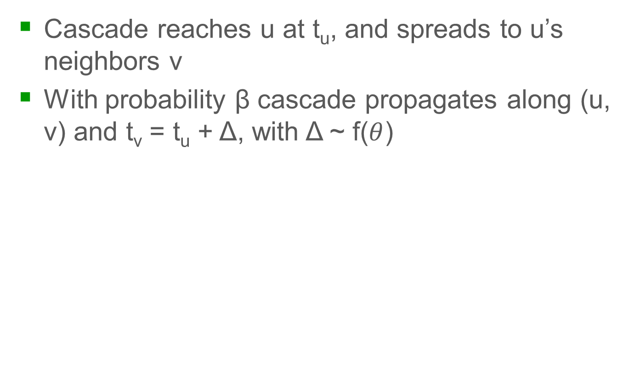
Cascade Generation Model
Cascade reaches u at t_{u}, and spreads to u’s neighbors v
With probability β cascade propagates along (u, v) and t_{v} = t_{u} + Δ, with Δ ~ f($θ$)
t_{a}
t_{b}
t_{c}
t_{e}
t_{f}
Δ₁
Δ₂
Δ₃
Δ₄
a
a
a
b
b
b
c
c
c
d
e
e
f
f
[Gomez-Rodriguez, Leskovec, & Krause, KDD 2010]

Slide 16
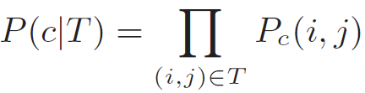
Likelihood of a Cascade
If u infected v in a cascade c, its transmission probability is:
P_{c}(u, v) ~ f(t_{v} - t_{u}) with t_{v} > t_{u} and (u, v) are neighbors
To model that in reality any node v in a cascade can have been infected by an external influence m: P_{c}(m, j) = ε
Prob. that cascade c propagates
in a tree T:
m
ε
ε
ε
a
a
b
b
c
d
c
e
e
[Gomez-Rodriguez, Leskovec, & Krause, KDD 2010]

Slide 17
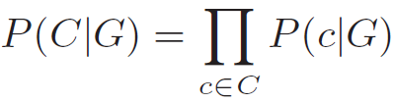
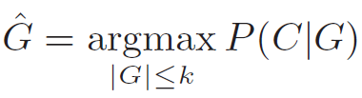
Finding the Diffusion Network
There are many possible propagation trees:
c: (a, 1), (c, 2), (b, 3), (e, 4)
Need to consider all possible propagation tree T supported by G
Likelihood of a set of cascades C on G:
Want to find:
a
a
a
a
a
b
a
b
b
b
b
b
c
d
d
d
c
c
c
c
c
e
e
e
e
e
e
[Gomez-Rodriguez, Leskovec, & Krause, KDD 2010]

Slide 18
An Alternative Formulation
We consider only the most likely tree
Maximum log-likelihood for a cascade c under a graph G:
Log-likelihood of G given a set of cascades C:
Problem is NP-Hard (Max-k-Cover)
Devise an algorithm to solve nearly optimal in O(N²)
[Gomez-Rodriguez, Leskovec, & Krause, KDD 2010]

Slide 19
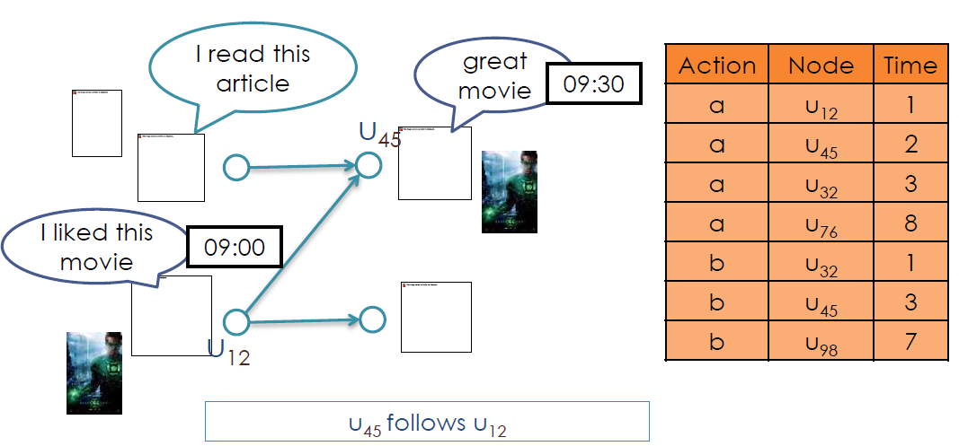
P3. Social Network is Given
Input data: (1) social graph and (2) action log of past propagations
Find: propagation weight on edges

Slide 20
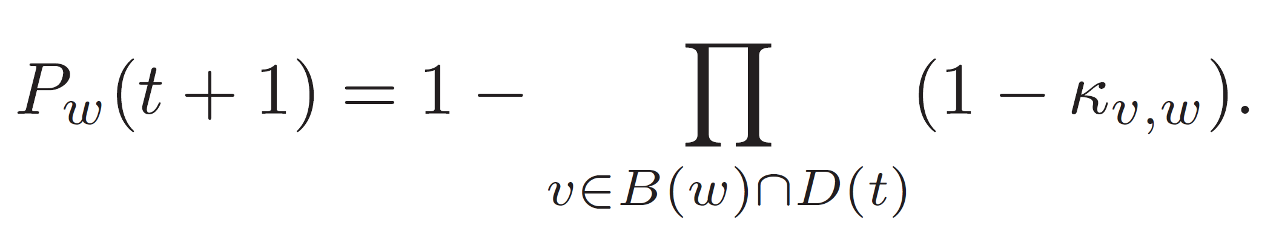
Constant Weight Model
Assume independent cascade model
Assume weights remain constant over time
Given
Network graph G
D(0), D(1), … D(t) → newly activated nodes at time t
For a link (v,w), node w is activated at (t+1) with prob
Diffusion prob
Parent set
Current active set
[Saito et al., KES 2008]

Slide 21
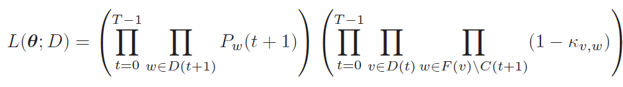

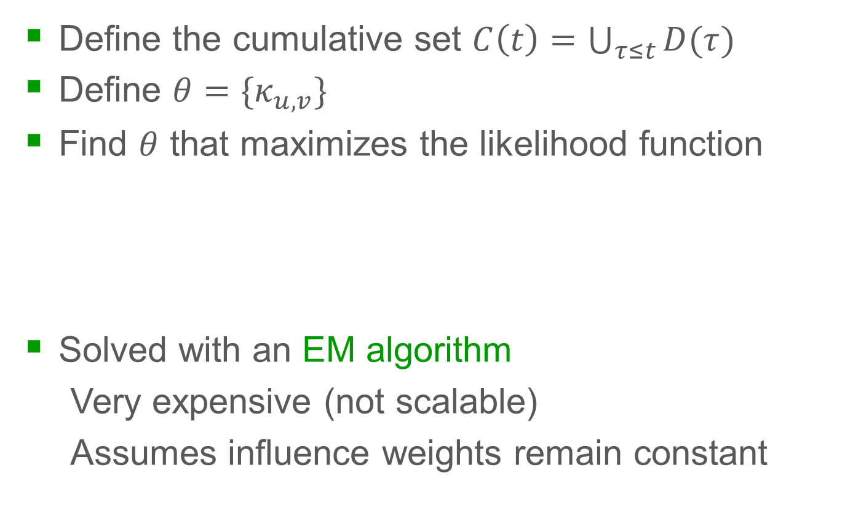
Constant Weight Model
Define the cumulative set $C\left(t\right)=\bigcup_{τ≤t}{D(τ)}$
Define $θ=\{κ_{u,v}\}$
Find $θ$ that maximizes the likelihood function
Solved with an EM algorithm
Very expensive (not scalable)
Assumes influence weights remain constant
Success prob
Failure prob
[Saito et al., KES 2008]

Slide 22
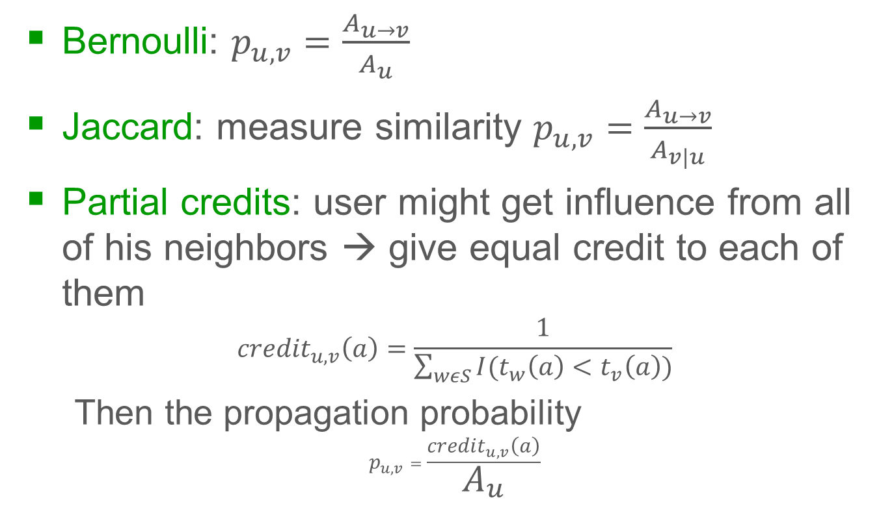
Static Models
Bernoulli: $p_{u,v}=\frac{A_{u→v}}{A_{u}}$
Jaccard: measure similarity $p_{u,v}=\frac{A_{u→v}}{A_{v|u}}$
Partial credits: user might get influence from all of his neighbors → give equal credit to each of them
$${credit}_{u,v}\left(a\right)=\frac{1}{\sum_{wεS}{I(t_{w}\left(a\right)<t_{v}\left(a\right))}}$$
Then the propagation probability
$$p_{u,v}=\frac{{credit}_{u,v}\left(a\right)}{A_{u}}$$
Actions spread u → v
Total actions of u
Actions of either
u or v
[Goyal, Bonchi, & Lakshmanan, WSDM 2010]

Slide 23
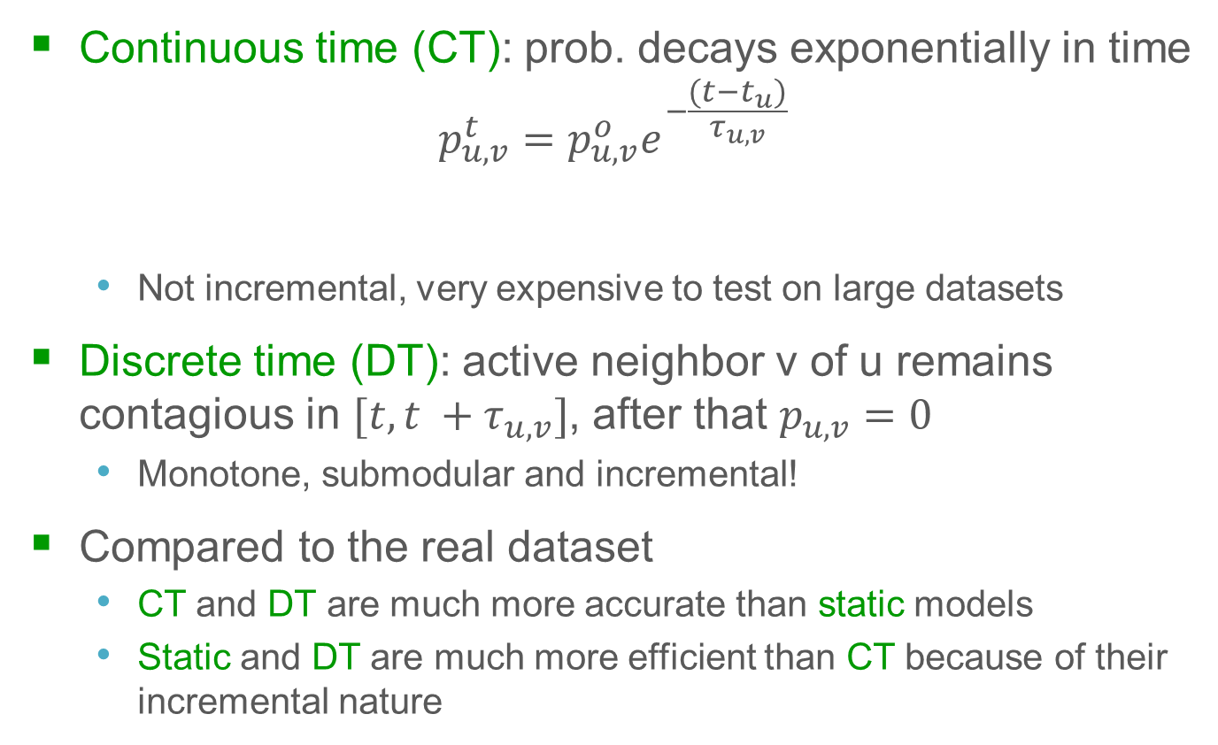
Time Varying Models
Continuous time (CT): prob. decays exponentially in time
$$p_{u,v}^{t}=p_{u,v}^{o}e^{−\frac{(t−t_{u})}{τ_{u,v}}}$$
Not incremental, very expensive to test on large datasets
Discrete time (DT): active neighbor v of u remains contagious in $[t, t +τ_{u,v}]$, after that $p_{u,v}^{}=0$
Monotone, submodular and incremental!
Compared to the real dataset
CT and DT are much more accurate than static models
Static and DT are much more efficient than CT because of their incremental nature
Time difference
Max strength
of u influence v
mean life time
(parameter)
[Goyal, Bonchi, & Lakshmanan, WSDM 2010]

Slide 24
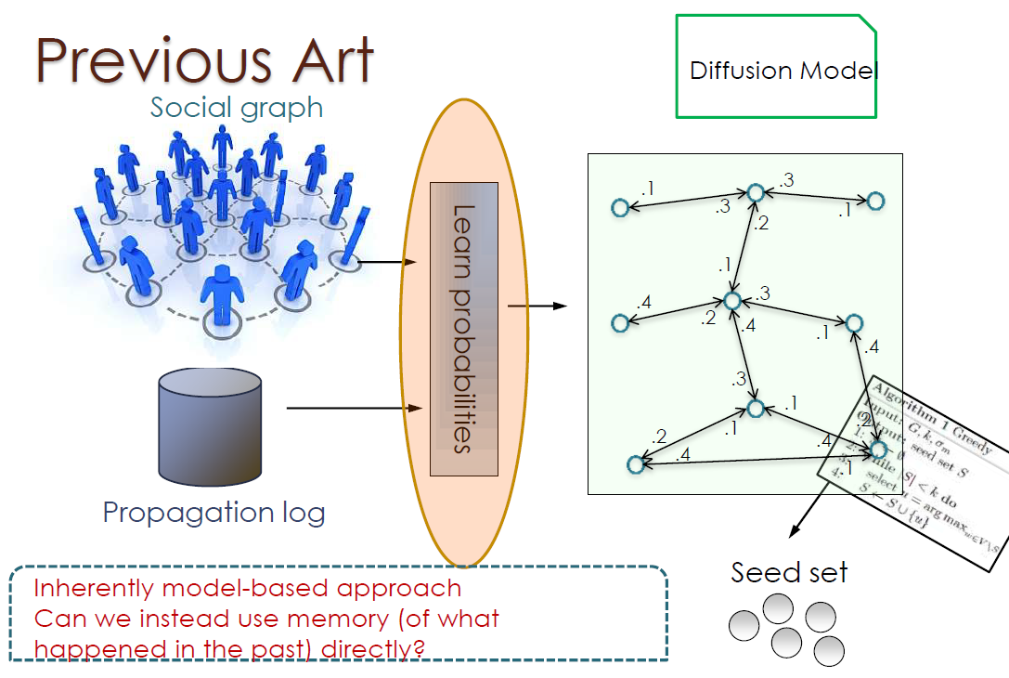
Data-based Influence Maximization

Slide 25
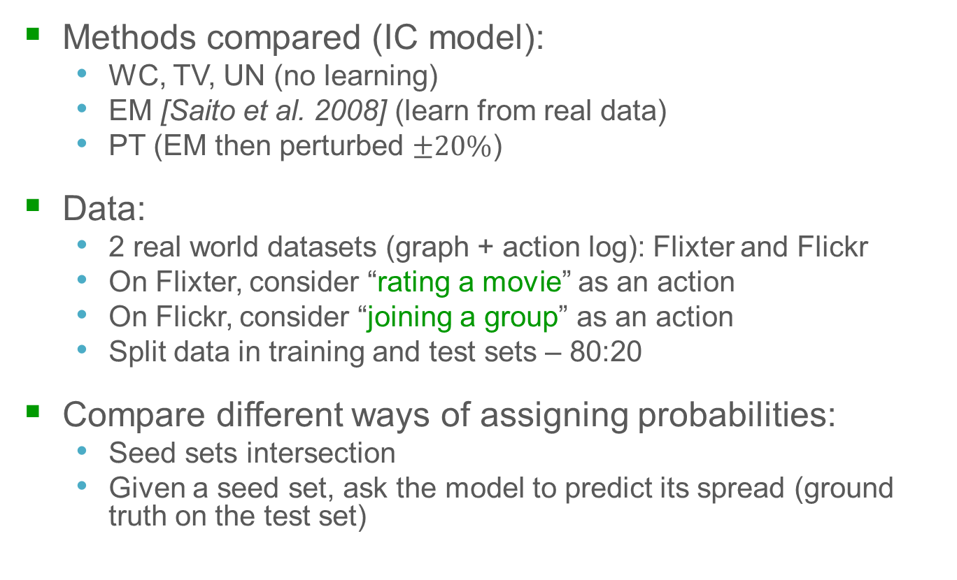
Why Learning from Data Matters
Methods compared (IC model):
WC, TV, UN (no learning)
EM [Saito et al. 2008] (learn from real data)
PT (EM then perturbed $±20\%$)
Data:
2 real world datasets (graph + action log): Flixter and Flickr
On Flixter, consider “rating a movie” as an action
On Flickr, consider “joining a group” as an action
Split data in training and test sets – 80:20
Compare different ways of assigning probabilities:
Seed sets intersection
Given a seed set, ask the model to predict its spread (ground truth on the test set)
[Goyal, Bonchi, & Lakshmanan, VLDB 2012]

Slide 26
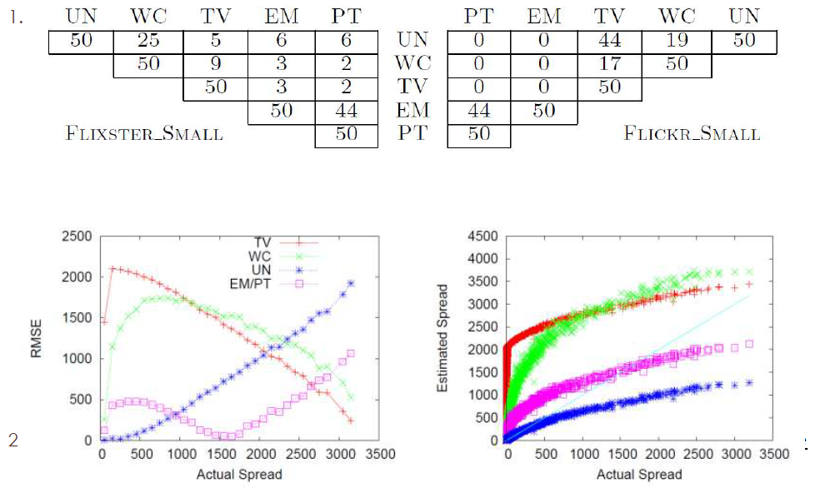
Why Learning from Data Matters

Slide 27
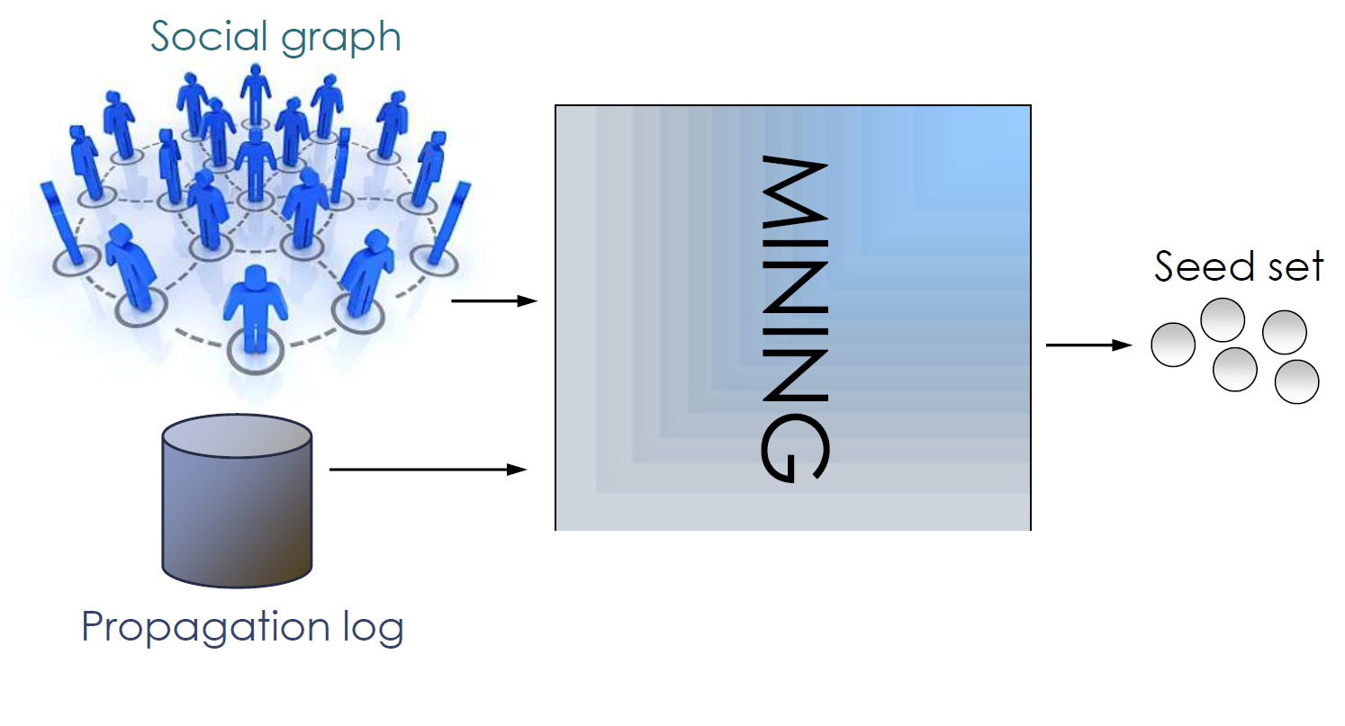
Direct Mining
THE SPARSITY ISSUE
[Goyal, Bonchi, & Lakshmanan, VLDB 2012]

Slide 28
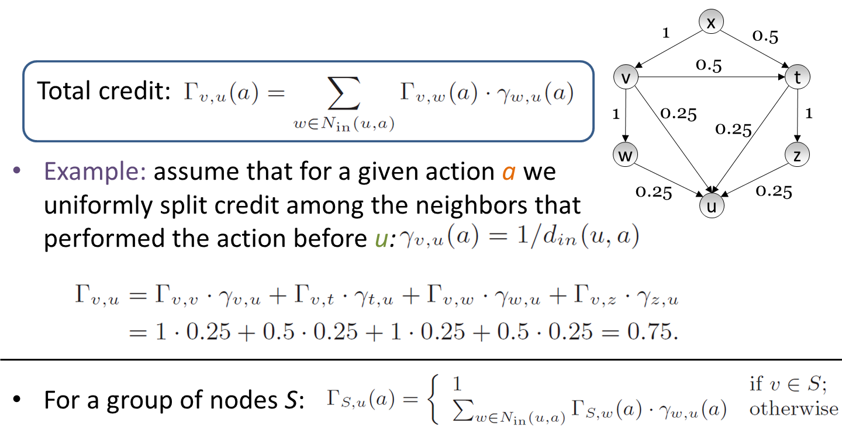
Credit Distribution Model
[Goyal, Bonchi, & Lakshmanan, VLDB 2012]

Slide 29
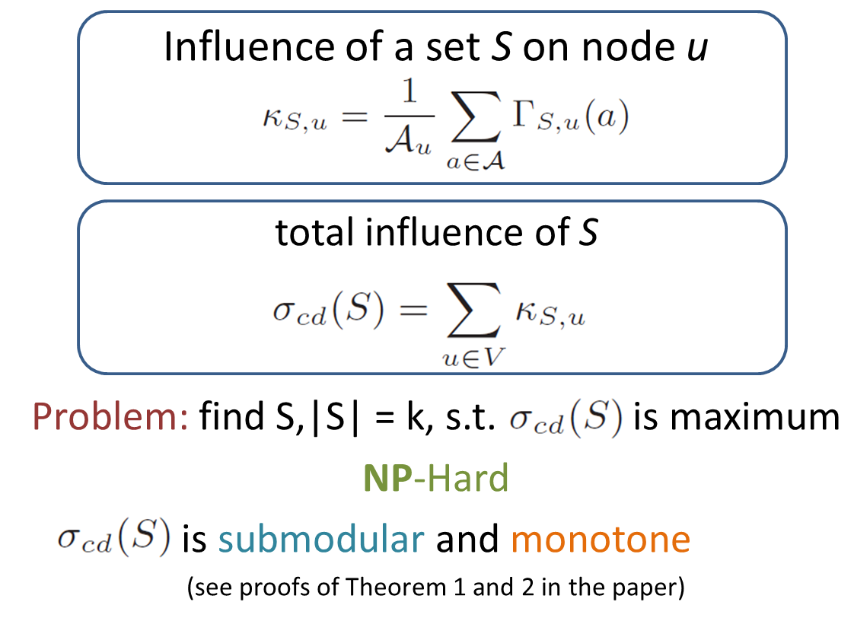
Credit Distribution Model
[Goyal, Bonchi, & Lakshmanan, VLDB 2012]

Slide 30
Key Takeaways
Influence network and weights not always available
Can be learned from the action log
[Gomez-Rodriguez et al. 2010] Infer social network
[Saito et al. 2008] Infer edge weights using EM
[Goyal et al. 2010] Infer static and time-conscious model
[Goyal et al. 2012] IM directly from the action log
Watch out for the sparsity issue

Slide 31
Part III Learning Social Rank and Hierarchy

Slide 32
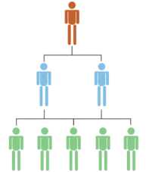
Social Rank and Hierarchy
Hierarchical vs. non-hierarchical networks
E.g.: corporation network vs. Twitter
Real world social networks don’t have rank (or do they?)
Can we study the ranking of each individual?
Do current ranking systems correct?
What is the best way to rank people on social networks?
# followers, influenceability, actions, recommendations, acknowledgement?
What kind of data is needed?

Slide 33

PageRank
Named after Larry Page (not because it ranks pages!)
The importance of a page is given by the importance of the pages that link to it
Two steps calculation
Initialize same value for all pages
Repeat until converge
Same concept can be applied for social ranking
importance of page i
importance of page j
pages j that link to page i
number of outlinks from page j
[Page & Brin, 1998]

Slide 34
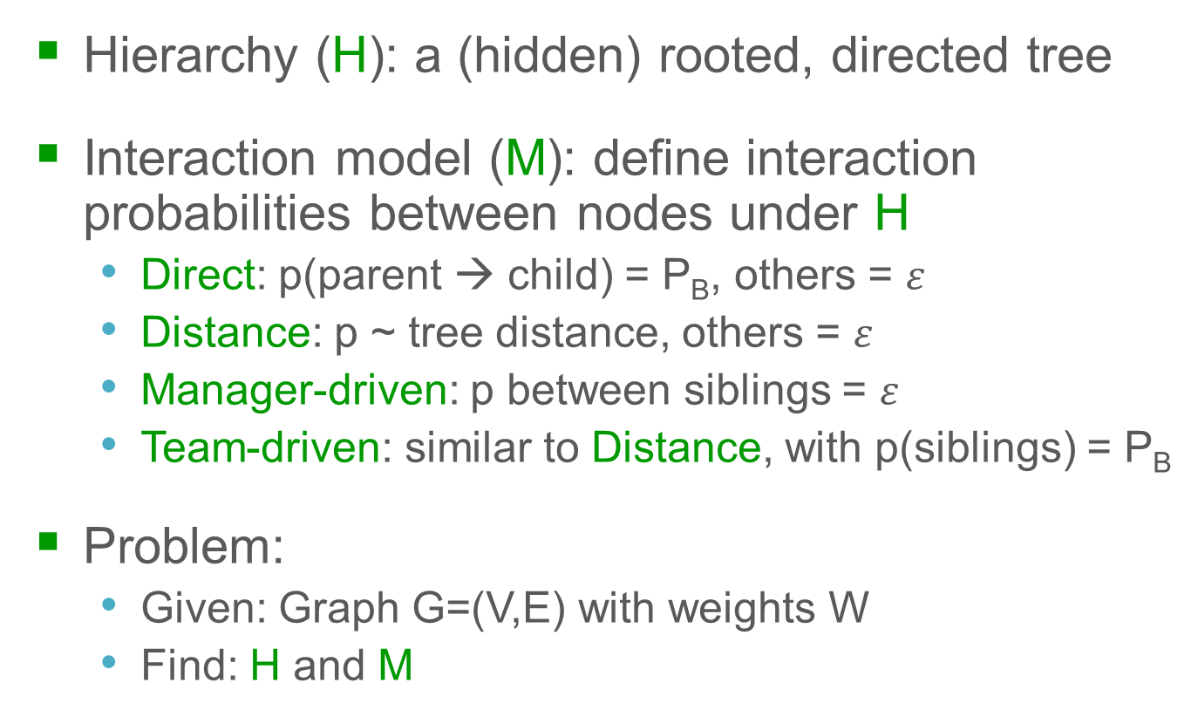
Finding Maximum Likelihood Hierarchy
Hierarchy (H): a (hidden) rooted, directed tree
Interaction model (M): define interaction probabilities between nodes under H
Direct: p(parent → child) = P_{B}, others = $ε$
Distance: p ~ tree distance, others = $ε$
Manager-driven: p between siblings = $ε$
Team-driven: similar to Distance, with p(siblings) = P_{B}
Problem:
Given: Graph G=(V,E) with weights W
Find: H and M
[Maiya & Berger-Wolf, CSE 2009]

Slide 35
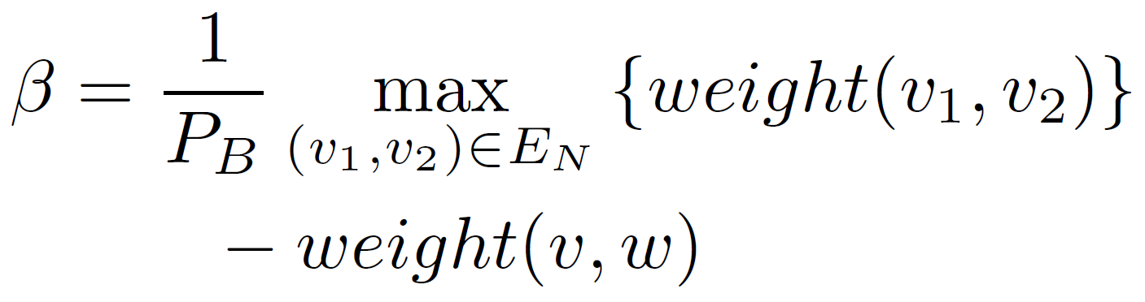
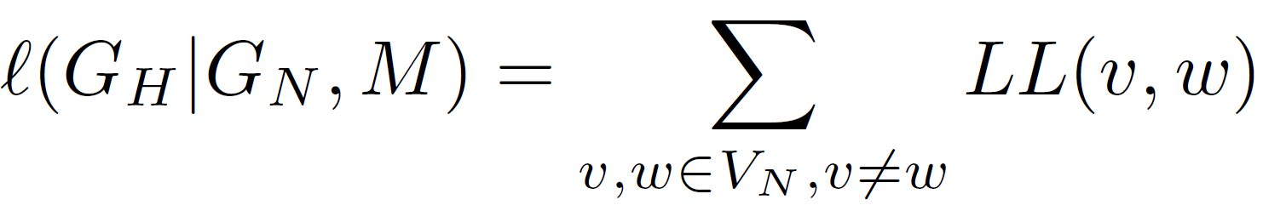
Finding Maximum Likelihood Hierarchy
For any pair of (v,w), LL function for the weight:
LL function of the entire hierarchy:
Using Greedy to find the hierarchy H with highest LL score & its model M
weight(v,w)
Prob. of interaction under the given model
[Maiya & Berger-Wolf, CSE 2009]

Slide 36
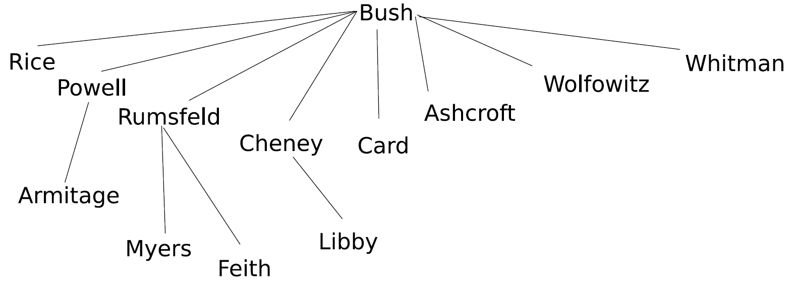

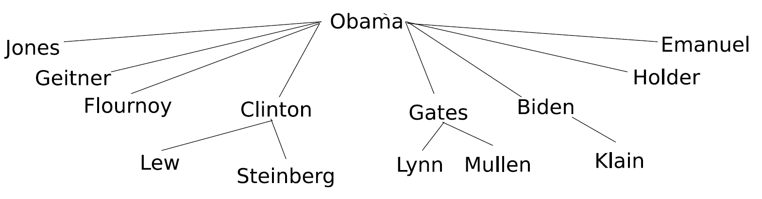
Finding Maximum Likelihood Hierarchy
Weight(x,y) = google “x told y”
High accuracy
Small scale data experiment
[Maiya & Berger-Wolf, CSE 2009]

Slide 37
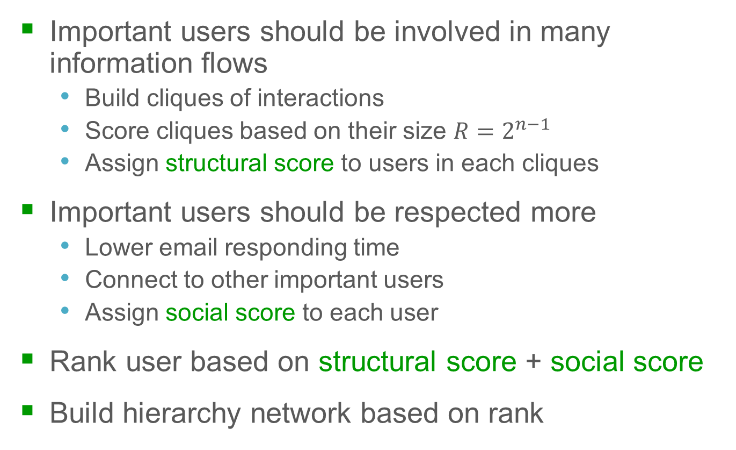
Hierarchy by Email Network Analysis
Important users should be involved in many information flows
Build cliques of interactions
Score cliques based on their size $R=2^{n−1}$
Assign structural score to users in each cliques
Important users should be respected more
Lower email responding time
Connect to other important users
Assign social score to each user
Rank user based on structural score + social score
Build hierarchy network based on rank
[Rowe, Creamer, Hershkop, & Stolfo, SNA-KDD 2007]

Slide 38
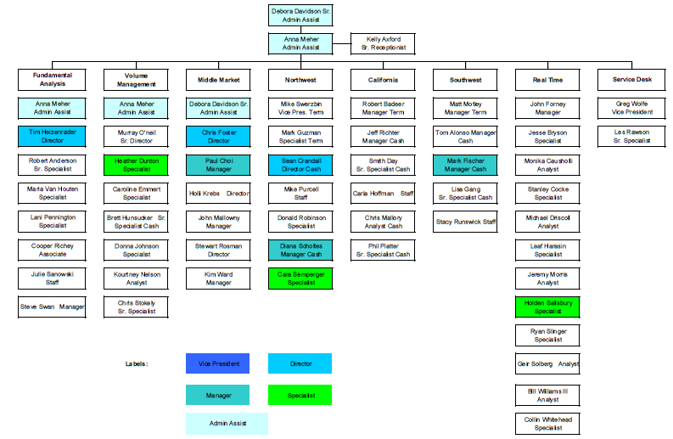
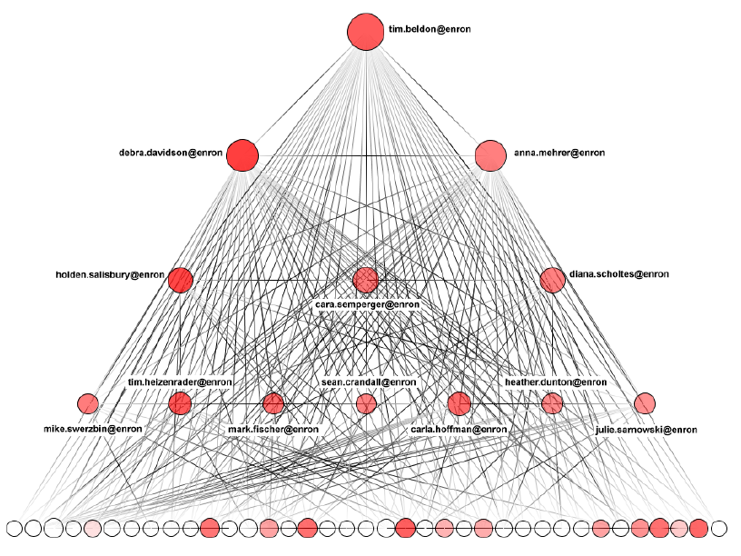
Hierarchy by Email Network Analysis
Inferred hierarchy is not even close to the ground truth
[Rowe, Creamer, Hershkop, & Stolfo, SNA-KDD 2007]

Slide 39
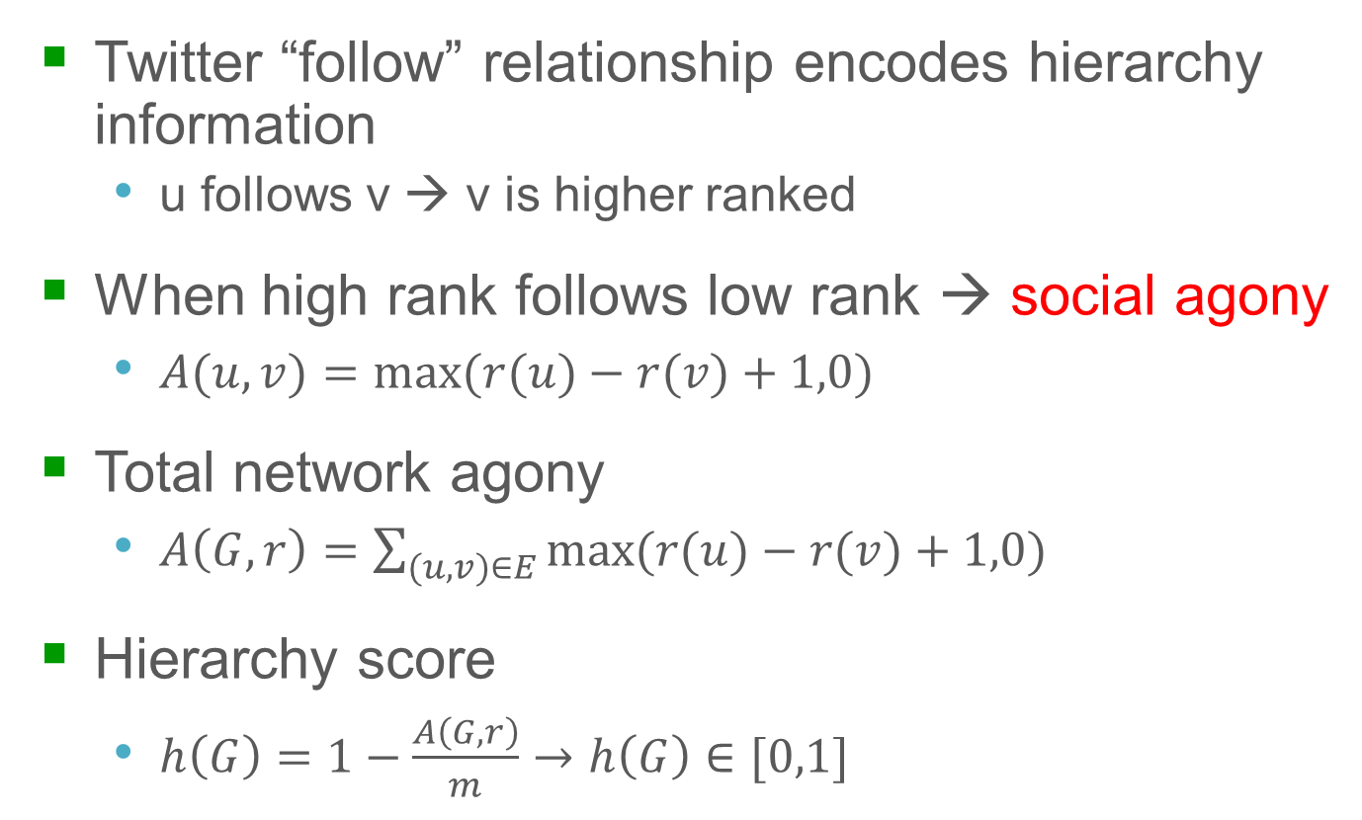
Hierarchy by Social Network Direction
Twitter “follow” relationship encodes hierarchy information
u follows v → v is higher ranked
When high rank follows low rank → social agony
$A(u,v)=max⁡(r(u)−r(v)+1,0)$
Total network agony
$A\left(G,r\right)=\sum_{(u,v)∈E}{max⁡(r(u)−r(v)+1,0) }$
Hierarchy score
$h\left(G\right)=1−\frac{A\left(G,r\right)}{m}→h\left(G\right)∈[0,1]$
[Gupte et al., WWW 2011]

Slide 40
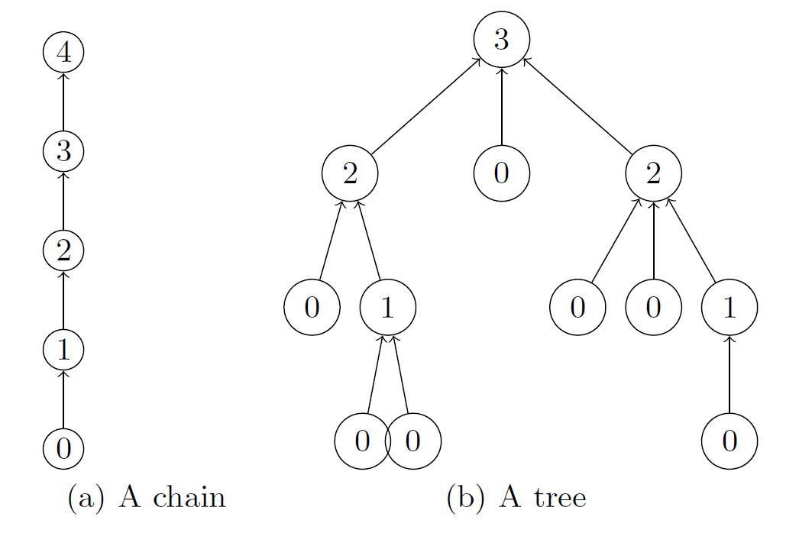
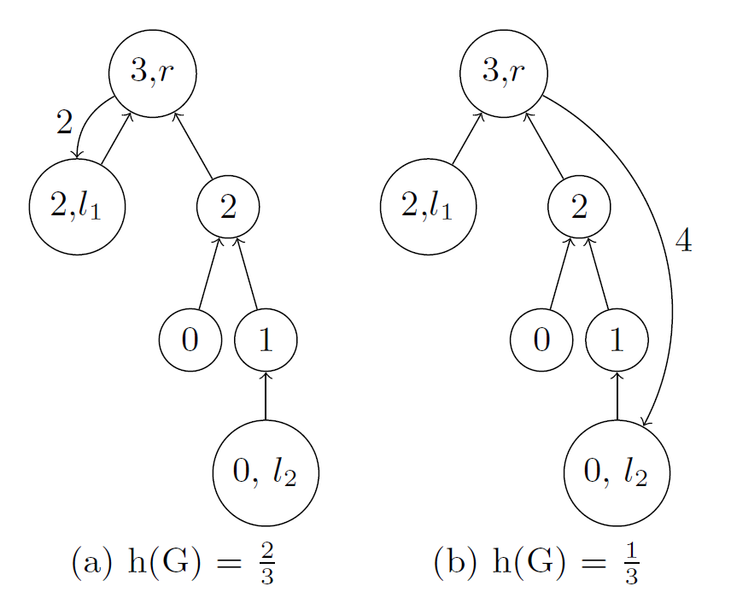
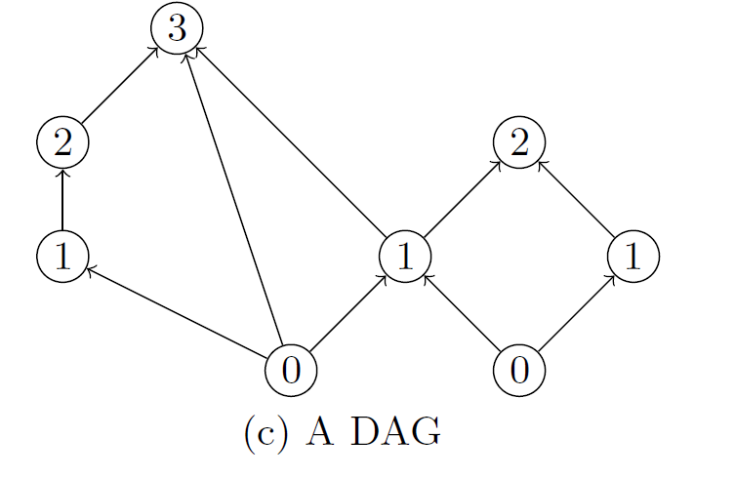
Hierarchy Score of Different Networks
[Gupte et al., WWW 2011]

Slide 41
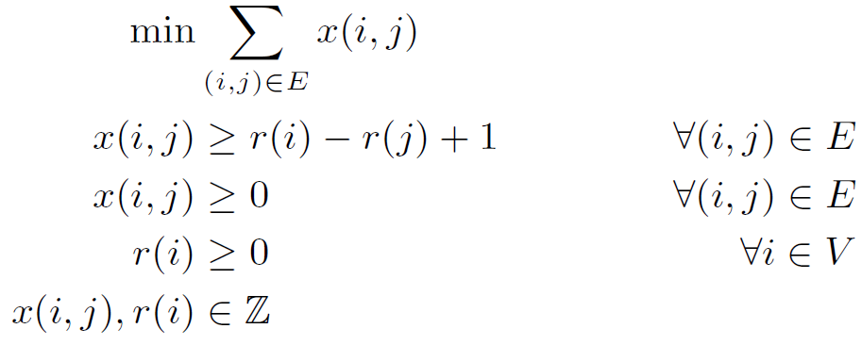
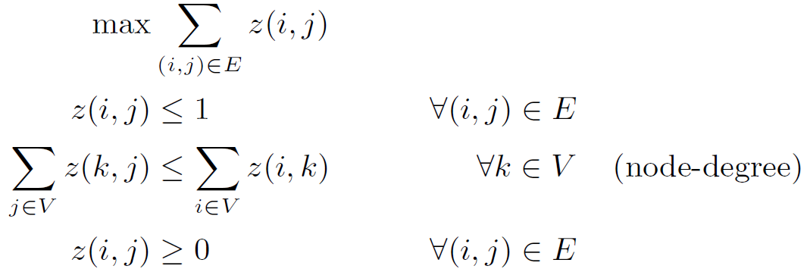
Finding the Rank
Find rank r to maximize the hierarchy score
Modeled as an integer program problem
Form a dual problem
Problem solved
[Gupte et al., WWW 2011]

Slide 42
Key Takeaways
Hierarchy affects social ranking
Many possible problem formulations and techniques
Make observations and assumptions carefully
There is no ground truth on social ranking
Obtaining a dataset with ranking is difficult
Difficult to say one method outperforms another
Scalability is an important factor
Should be considered when design a solution

Slide 43
Part IV Research Challenges

Slide 44
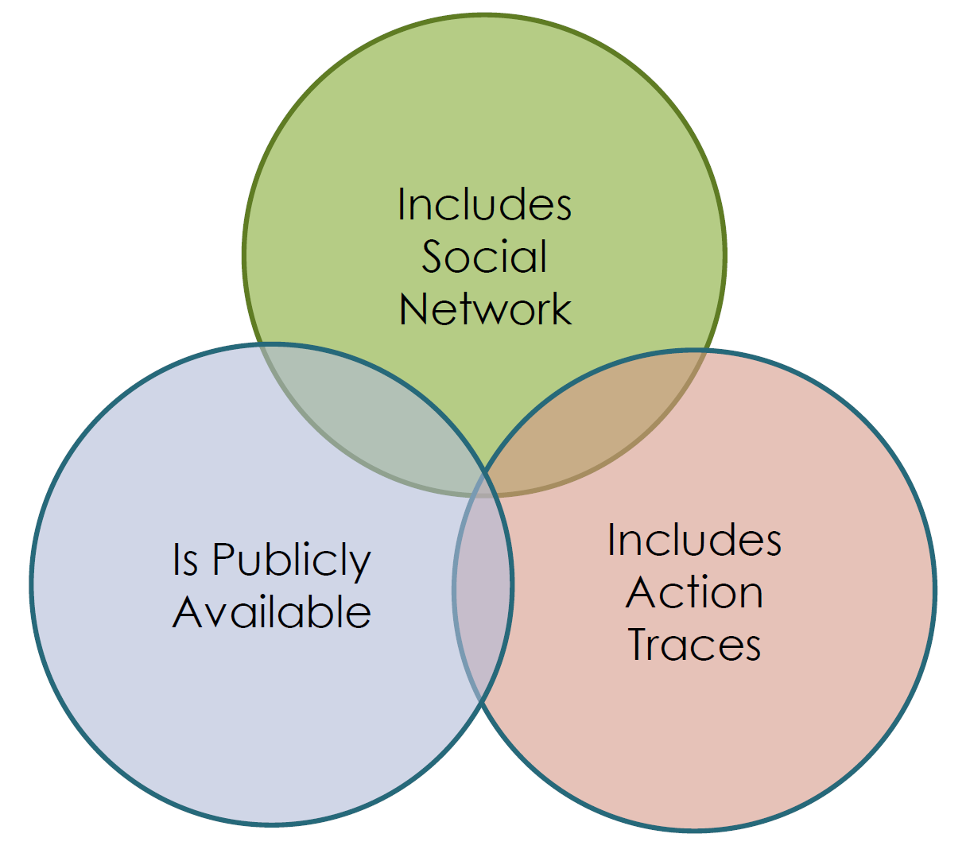
Data Availability
Data availability limits research
Often you have to pick two of those:
Data availability classification
Proprietary, impossible or very hard to reproduce (e.g. shopping history) → increasingly being rejected in IR, DM communities
Proprietary, reproducible (e.g. web crawl of a public website)
Existing open dataset – extensively studied
New open dataset

Slide 45

Value for Business and Social Sciences
Measuring effectiveness of influence and ranking is not easy in general
Compare viral vs. traditional marketing?
How does ranking help except for “showing off”?
Online data may be huge, but it is often neither representative nor complete
Can someone prove the effectiveness of Obama’s 2012 presidential campaign by Twitter?
Offline data (human interaction) is difficult to obtain
Also suffers from external influence (e.g. mass media, online …)
Lab experiment?

Slide 46
Learn to Design for Virality
What makes a product/idea/technology viral?
Role of content?
Role of seeds?
Other factors?
How can we artificially design something that goes viral or achieve high ranking?
What do we know about the factors behind successful viral phenomena (e.g. Gangnam style, Justin Beiber …) ?

Slide 47
Misc. Technical Challenges
Algorithmic challenge: O(n²) algorithms are not feasible for large graph (e.g. n = 1 bil)
Need near-linear time algorithms (O(n.log(n)) maybe?)
Many ranking systems exist
Which one should we trust?
Dynamic factor of social networks
Influenceability and rank changes over time
Competitive diffusion and ranking
Measure the effect of adversaries?

Slide 48
Concluding Remarks
Great advances in theory, analysis, and algorithms
Many challenges exist down the line
Many problems are yet to be defined and solved
Big thanks if you haven’t fall asleep :)

